Slide 1
SFP Demo Configuration Handbook WxCC 2.0
CCBU Solution Assurance
Document version 1.0
8-12-2020

Slide 2
What is this about ?
What is this Not about ?
Anyone with a WxCC 2.0 tenant access should be able to configure it to demonstrate the capabilities of this platform in their own demo/Gold tenants.
This handbook will be shared internally first (TME, TSA, Sales, Mktg) and eventually to partners in EFT
This is a ‘living document’, more capabilities will be added as they become available
This helps provide a consistent demo experience
Please glance over once to get the over-view. This is not super detailed, we assume you have most of the basic steps needed….
Training/Deep dive session
Step by Step demo guide/story with speaker notes (Will be a separate effort)

Slide 3
Overall Pre-Requisites / Assumptions
1 | Steps in this guide are based on and for configuring a tenant in production environment
2 | Users of this guide already have administrator access to a production tenant
3 | Voice connectivity is available on the production tenant
4 | DN to EP mapping is done with a working DN
5 | Users of this guide already have Email ID for email contact routing
6 | Users of this guide already have a SMS Number procured from MessageBird, that can be integrated with the tenant.
7 | Users of this guide already have a Facebook page which can be integrated with the tenant
8 | Users of this guide already have a Google CCAI account that can be configured in the tenant
9 | Tenant has Feature Flags enabled for desktop layout, Chat/Email, Virtual Assistant, Social, FlowControl
10 | All config entities are created with prefix MediAssist For example: Site: MediAssist_Site, Team: MediAssist_Team, EP: MediAssist_Voice_EP

Slide 4
Config Handbook - Who & Where ?
Module-1 | User Onboarding | Ankt
Module-2 | Chat | Abhishek
Module-3 | Email | Naveen
Module-4 | Social | Chandra
Module-5 | Voice | Avinash
Module-6 | WxM Post Call Survey | Raghu
Module-7 | External DB Dips | Chandramouli
Module-8 | Agent Desktop(KAD) | Sameer
 | Support/Facilitator | Gagarin
 | Reviewers/Mentors | Karthik/Mudit
Environment | ProdUS1 (WxCC US DC)
Org | Webex CC Demo 101
Org ID | 12700722-cd25-46b9-971e-ed0ce9f140c6
Access | <cec>@email.carehybrid.com
Control Hub | https://admin.webex.com
Portal | https://portal.wxcc-us1.cisco.com/portal/home.html
Agent Desktop | https://desktop.wxcc-us1.cisco.com
Main IVR | 516-517-9009
Sample API for Ext. DB Dip | https://5f9a64f59d94640016f709bf.mockapi.io/api/customers/account

Slide 5
Module 1
Voice Configuration

Slide 6
Objective: You will be able to initiate a voice call to the Contact Centre and be able to accept call with your Agent/Sup
Pre-Requisites/Assumptions
Outcome
Pre-Req/Assumption | Comments
New user (Supervisor/Agent) is already created | Module 1
Agent is able to login to agent desktop | Module 1
Pre-Req/Assumption | Comments
Map DiD to an Entrypoint
Be able to accept voice call in agent desktop

Slide 7
Objective: This lab is designed to ensure we onboard various user personas in to WxCC.
As part of this guide, we will cover following steps:
**Important: Lets use a naming convention in order to help us maintain this tenant. Please use the format from below. Most important, always lead with you username.
Voice Configuration:
Create EP = <username>_voice_EP ie: (ntheolog_voice_entrypoint)
Map DiD to your EntryPoint.
Create your Team = <username>_team
Create Q = <username>_voice_Q
Create EP Routing Strategies = <username>_RS_voice_EP
Create Q Routing Strategies = <username>_RS_voice_Q
Associate Teams to respective Q

Slide 8
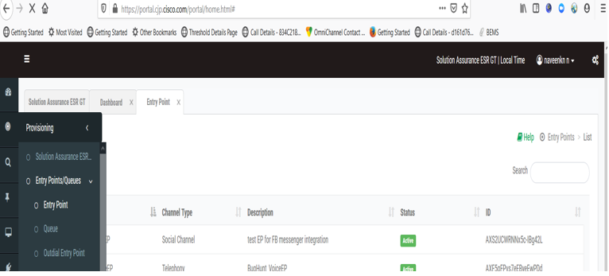
Step1: Voice Entry Point
Customer admin logins to “WXCC Management Portal” URL https://portal.wxcc-us1.cisco.com with the credentials and accesses the menu ‘Provisioning → Entry Point/Queues → Entry Point’.

Slide 9
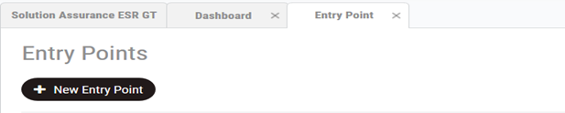
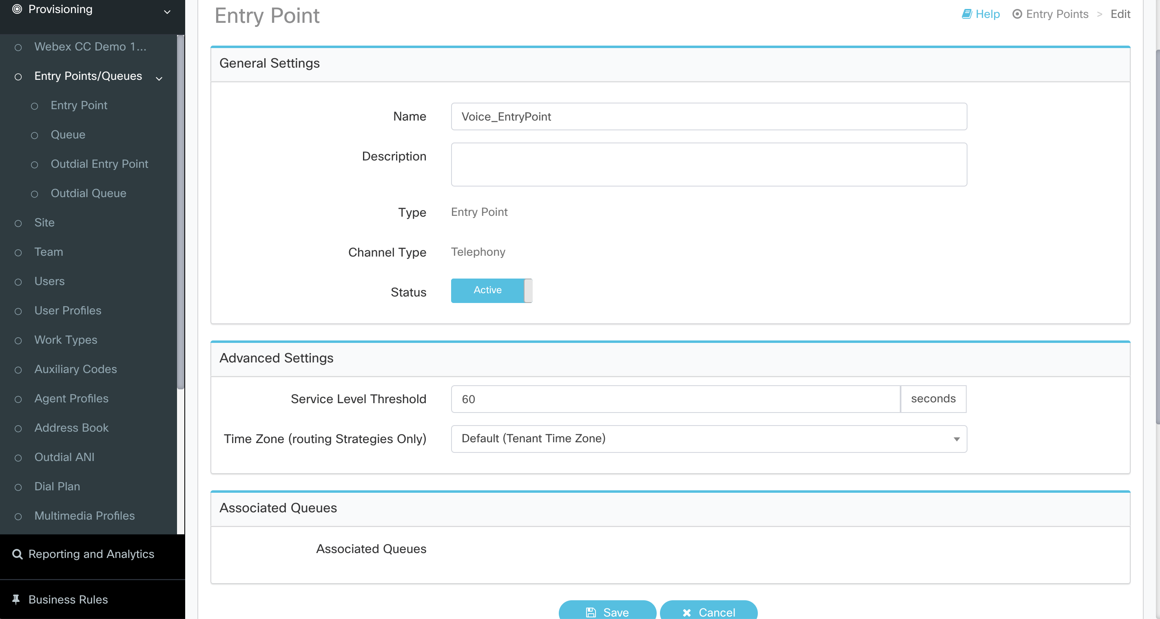
Step2: Voice entry point (Cont.)
Select “New Entry Point” and enter the respective values and click save

Slide 10
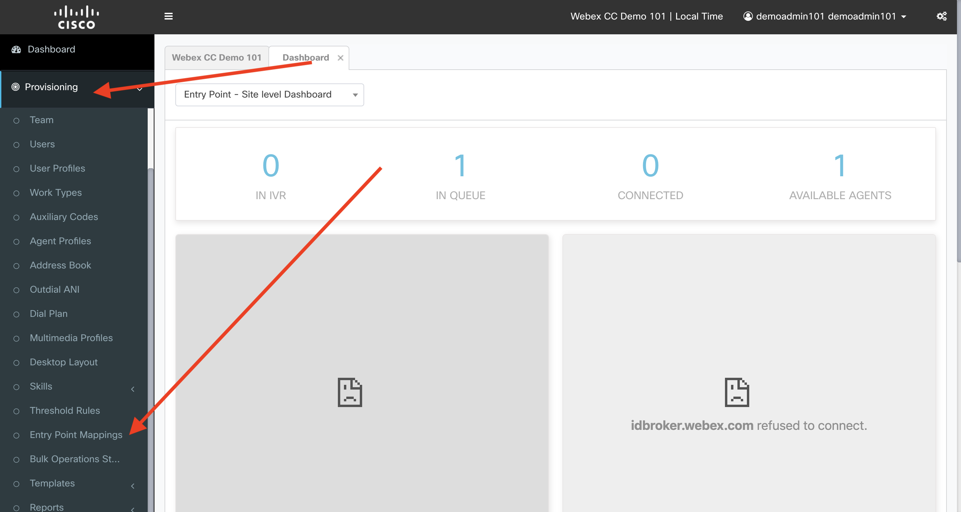
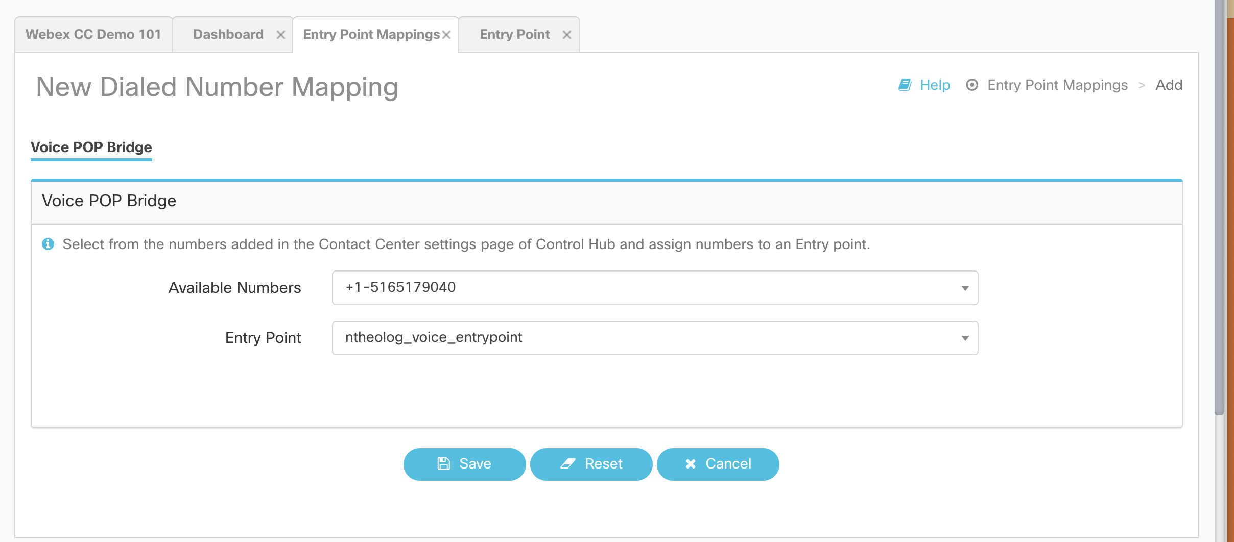
Step3: Map DiD
Select “Entry Point Mapping”
Click “New Mapping
Select the first available DiD
Chose your newly created entryPoint
save

Slide 11
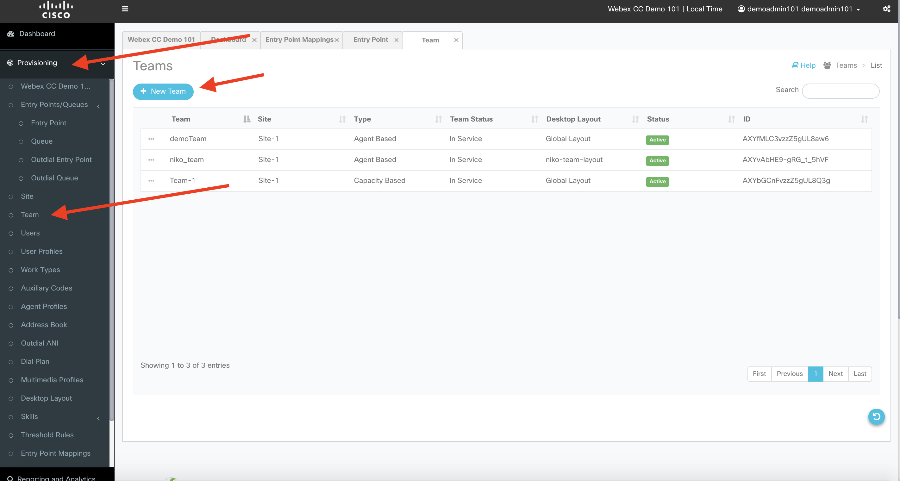
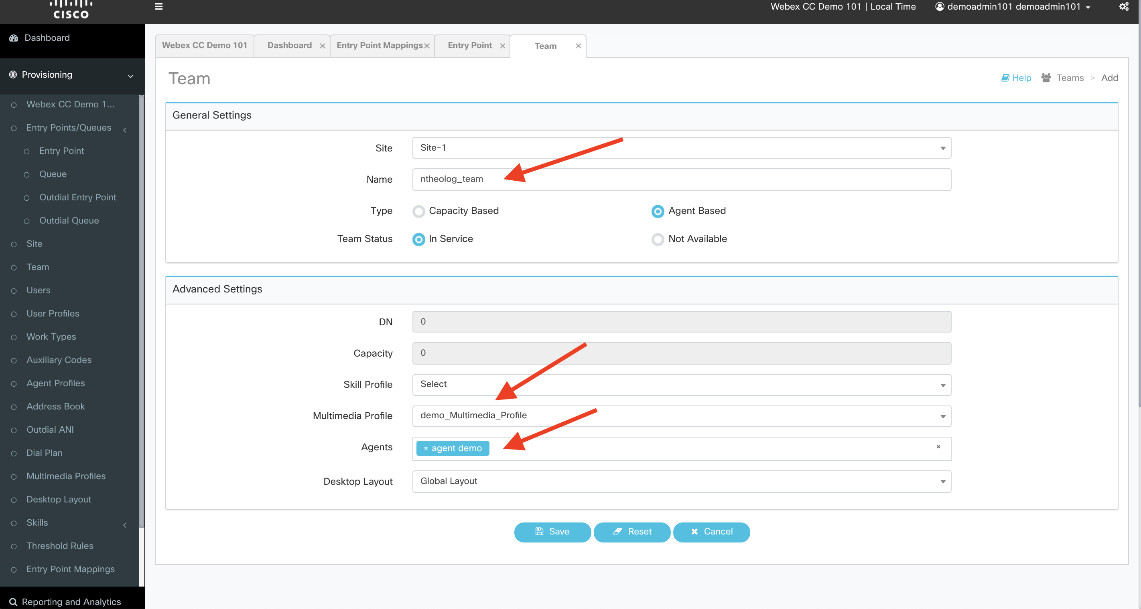
Step4: Create your Team
From the navigation:
Click Provisioning
Click “Team”
Click “New team
Give it name: <username>_team. ie: ntheolog_team
Select demo_Multimedia_Profile
Choose your agent

Slide 12
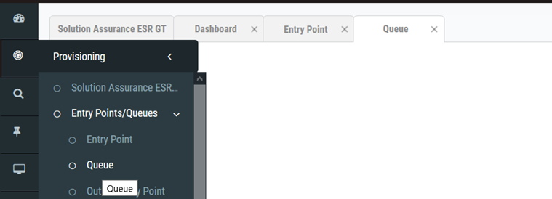
Step5: Voice queue
Customer admin access the menu ‘Provisioning → Entry Point/Queues → Queue’

Slide 13
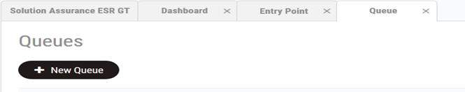
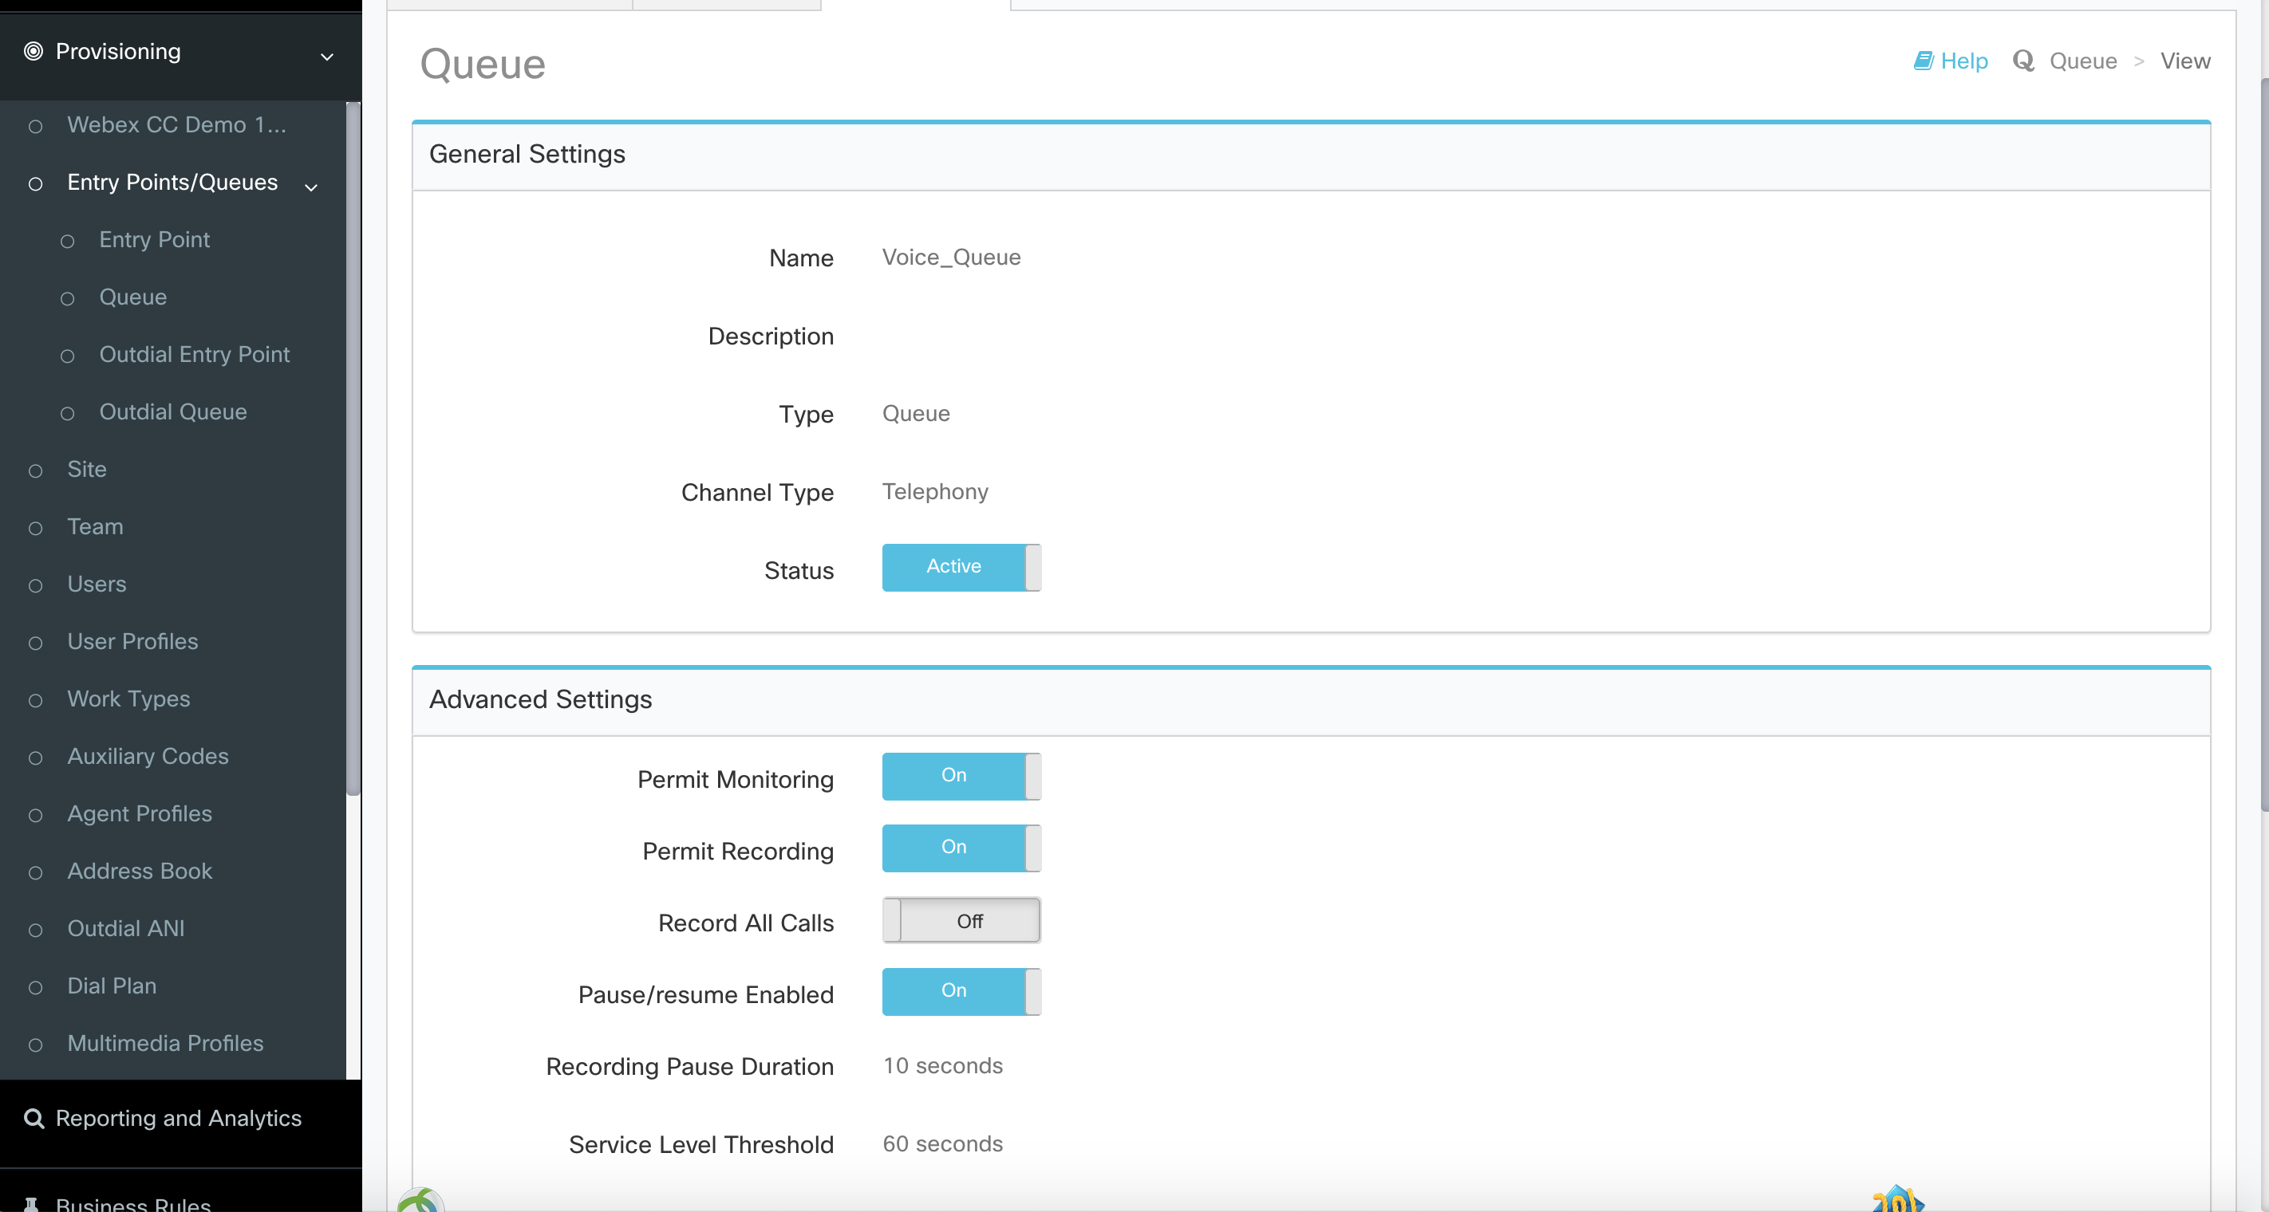
Step6: Voice queue (Cont.)
Select “New Queue” and enter the respective values and click save

Slide 14
Note:
For the sake of keeping this exercise module and simple, we will use an existing Voice flow.
In another Module, we will spend more time on Creating a Flow
Reason
For most of you this is basic stuff, but one of the purposes of this exercise is to get everyone comfortable and also to create a naming convention and a format going forward in order to help us maintain this tenant and to quickly troubleshoot.
Gotchas: If you have issues getting into the Flow… or even the Portal… and you tend to go from tenant to tenant, its possible its holding on to cache. Either clear your cache or use an Incognito/private browser or even a different browser ( if youre on Chrome, use Firefox or vicee versa ) thanks

Slide 15
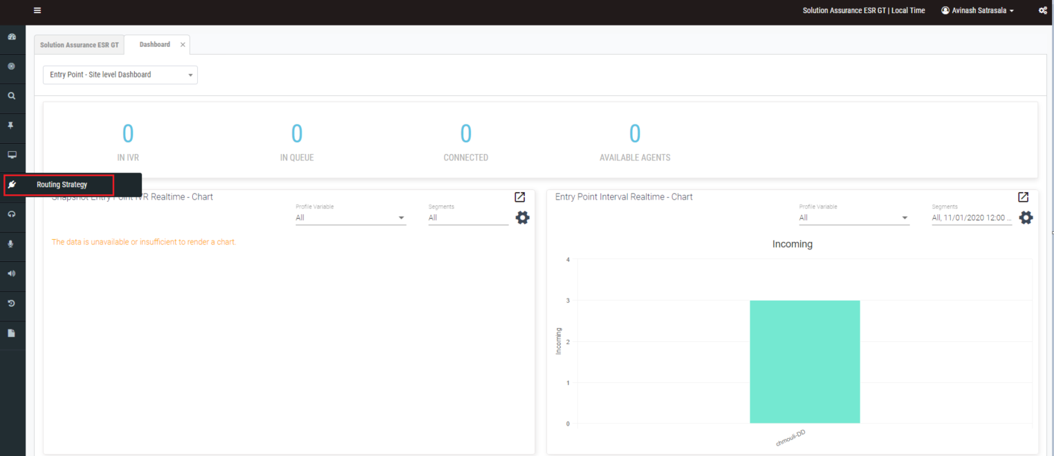
Step1a : Login to WxCC Portal and Select Routing Strategies

Slide 16
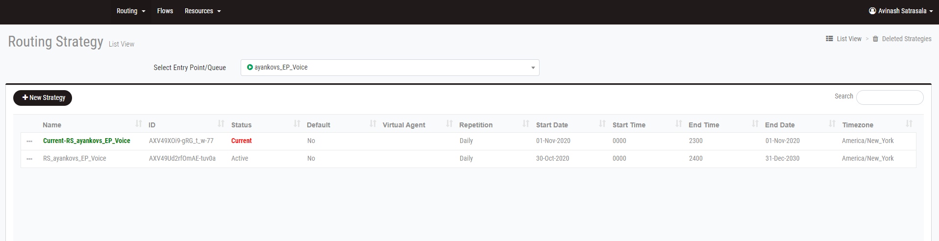
Step 2a: Select Flows in Routing Strategies page

Slide 17
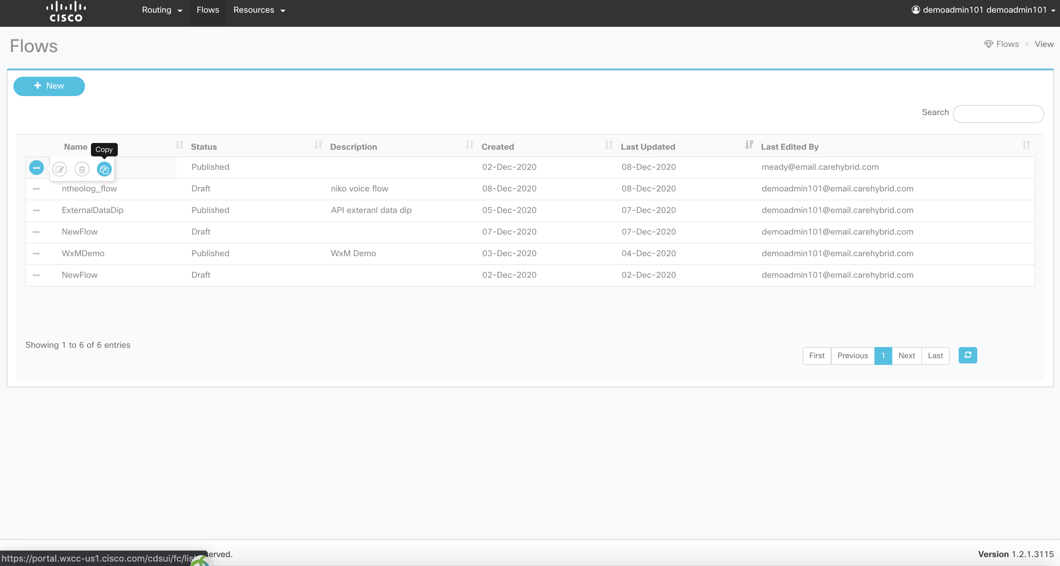
Step 3a: Select The flow named: SA-Demo, click it and choose copy
**IMPORTANT- The Flow editor auto-saves, always best to make a copy of a flow and then you can view it – especially if it's not your flow that you are looking at.

Slide 18
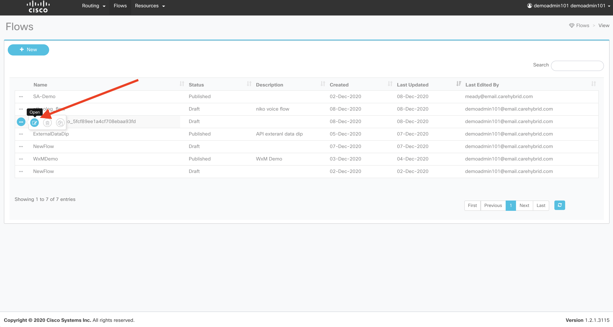
Step 4a: Once its copied, then select the newly created flow and Click ‘Open’….

Slide 19
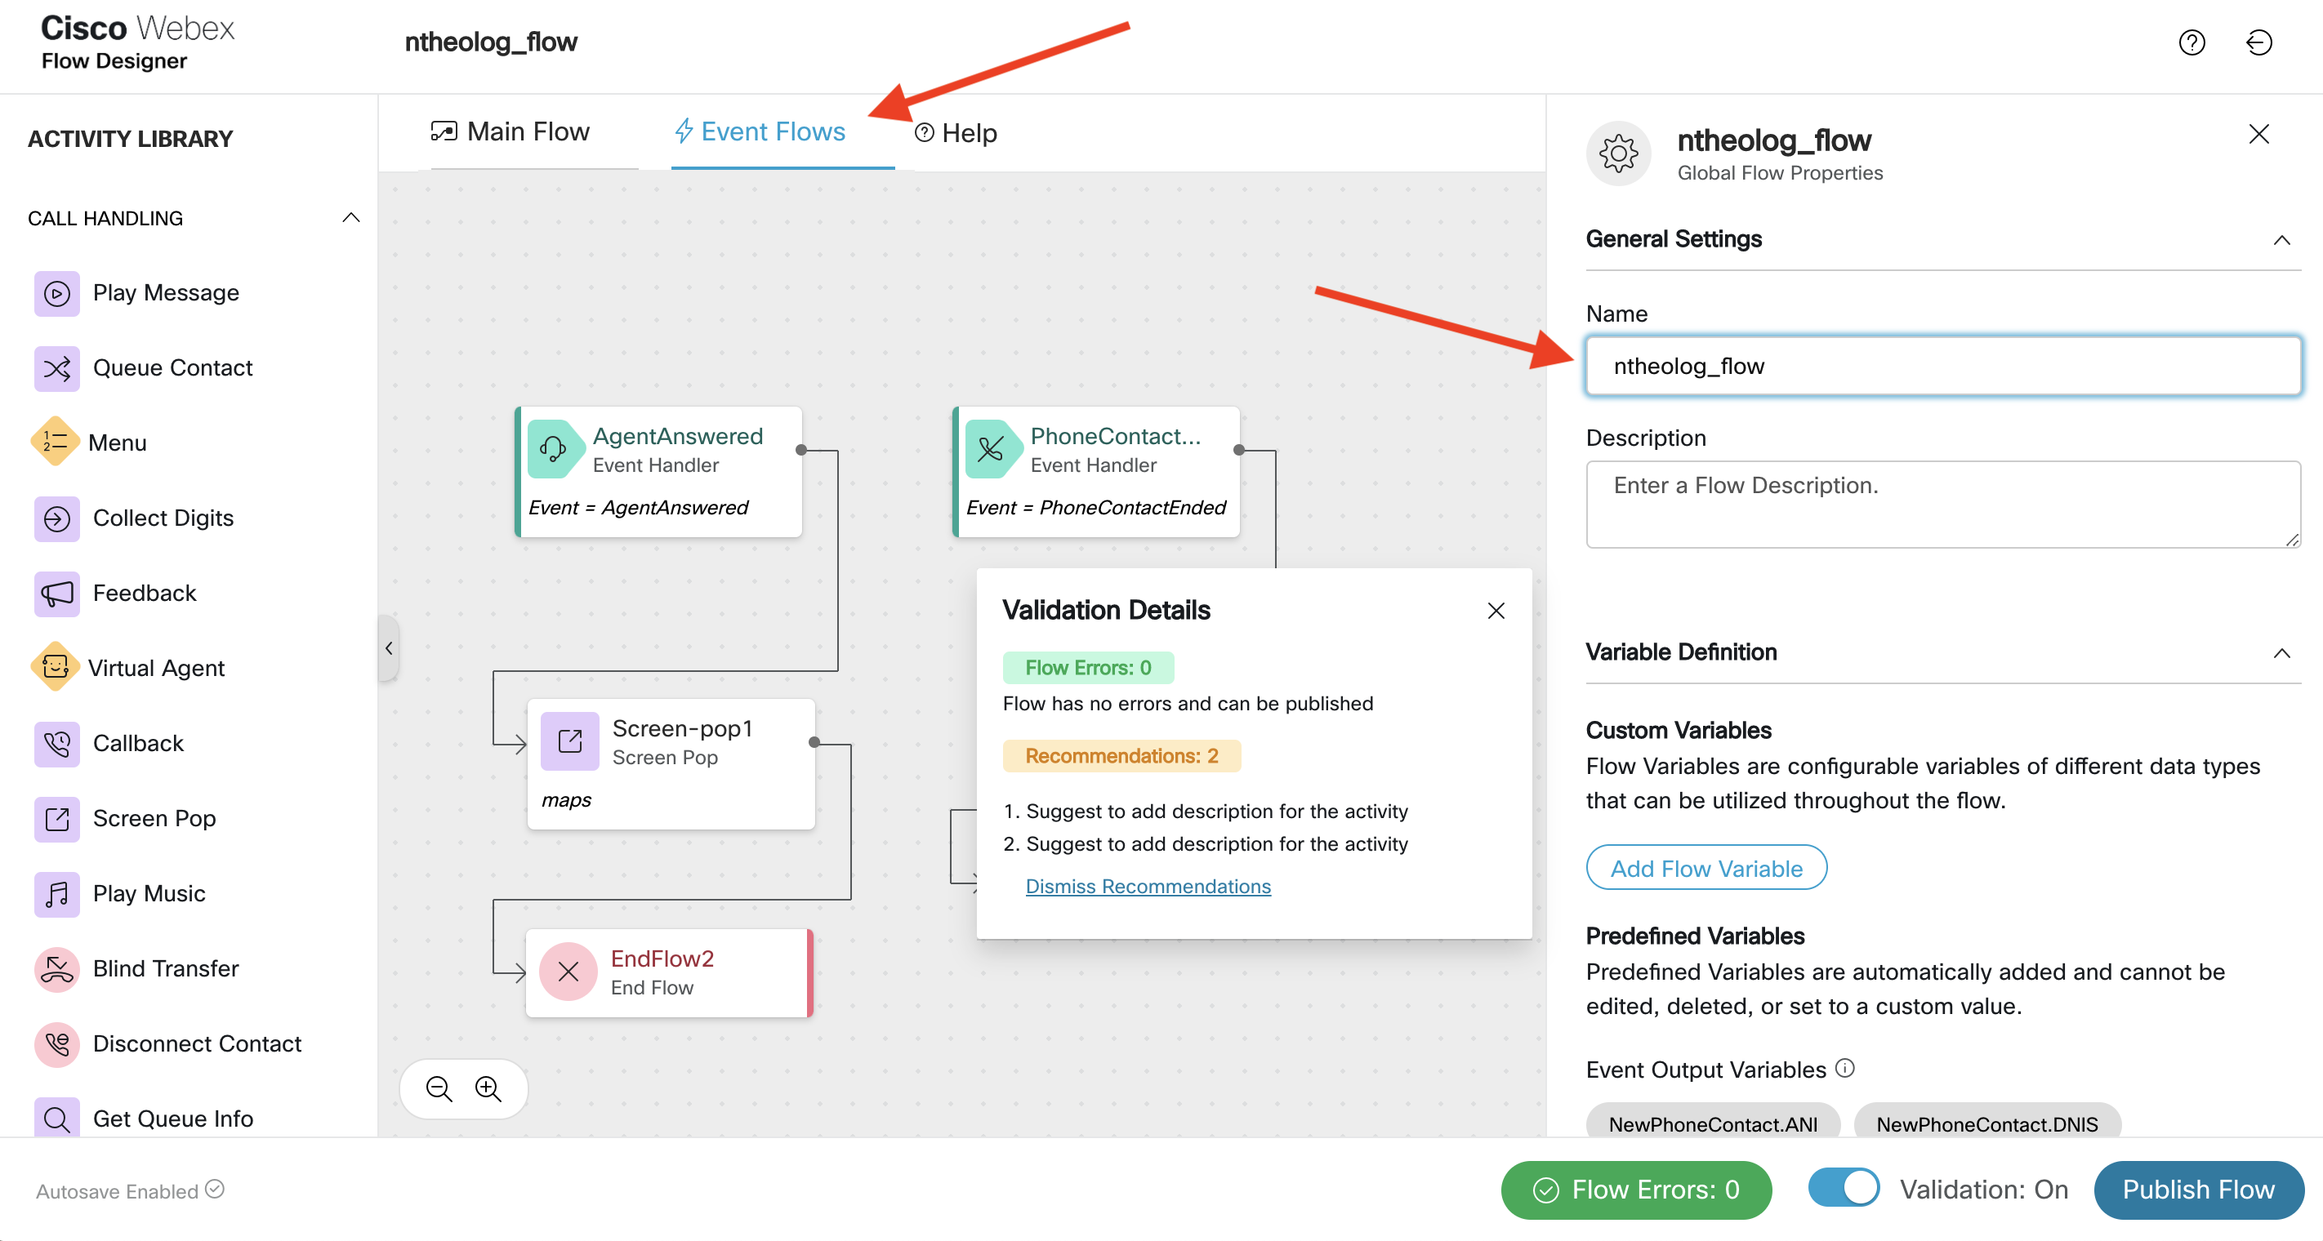
Step 5a: click on Event Flow and lets give it our unique name….

Slide 20
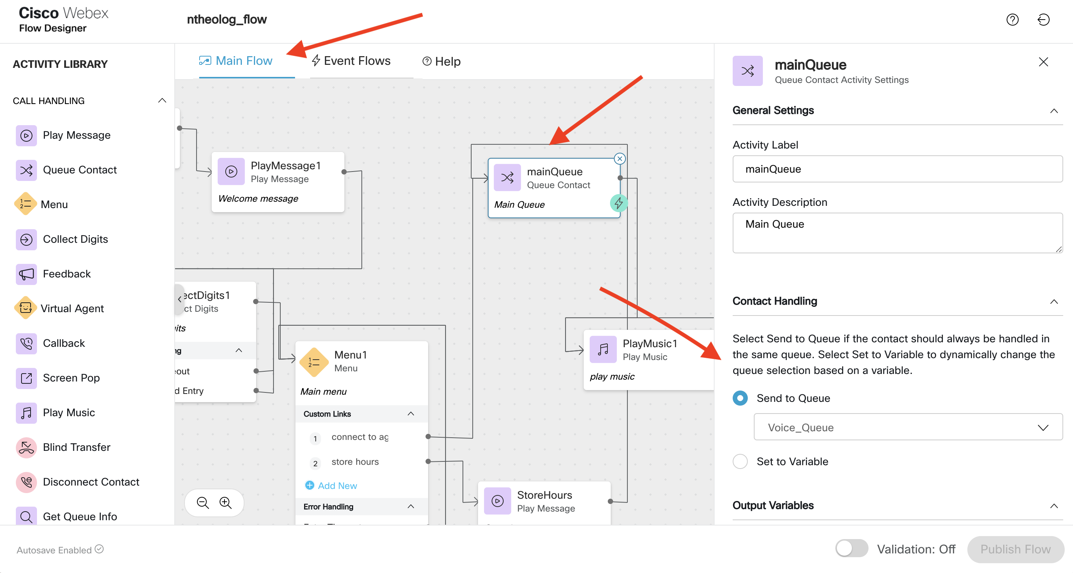
Step 6a:
Click on Main Flow
Click on the ‘mainQueue’ box (you might have to scroll to the right)
On the ‘Contact handling’ section, pull-down to select your voice queue

Slide 21
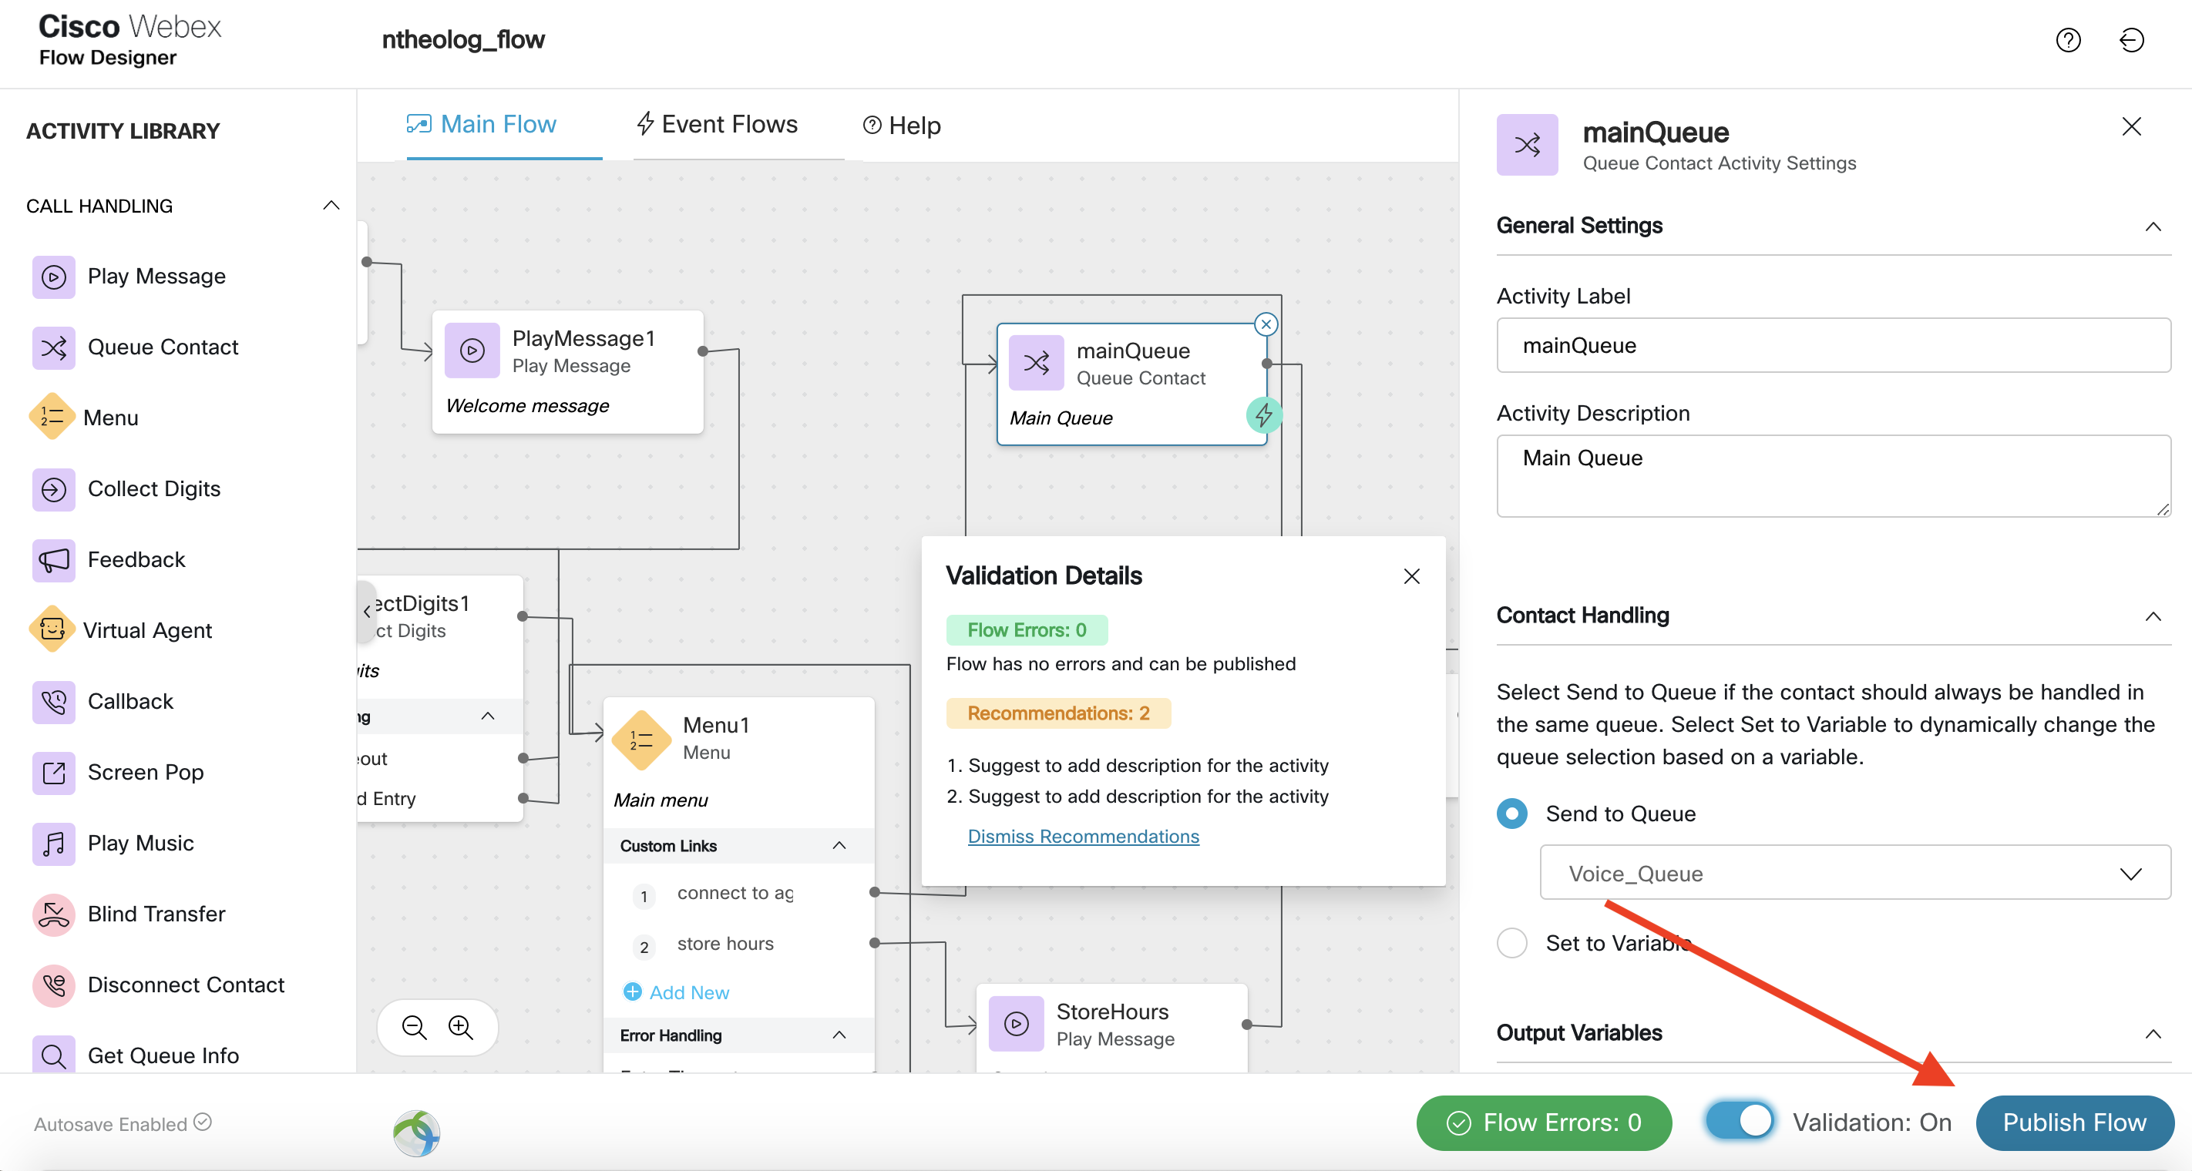
Step 7a:
Click Publish Flow (if its greyed out make sure Validation is “On”)

Slide 22
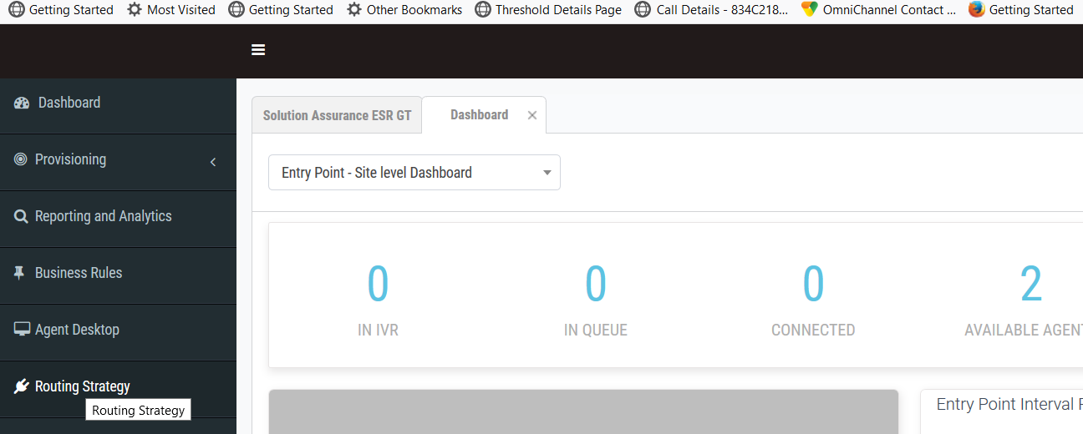
Step8: Entry point routing strategy
Customer admin access the menu and clicks ‘Routing Strategy’ which cross launches the routing strategy page.

Slide 23
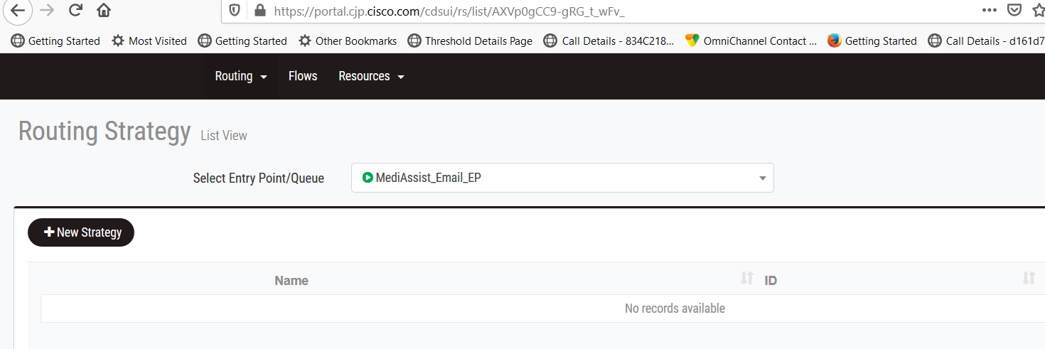
Step9: Entry point routing strategy (Cont.)
Select the ‘voice entry point’ that you created from the drop down and click on ‘New Strategy’ button

Slide 24
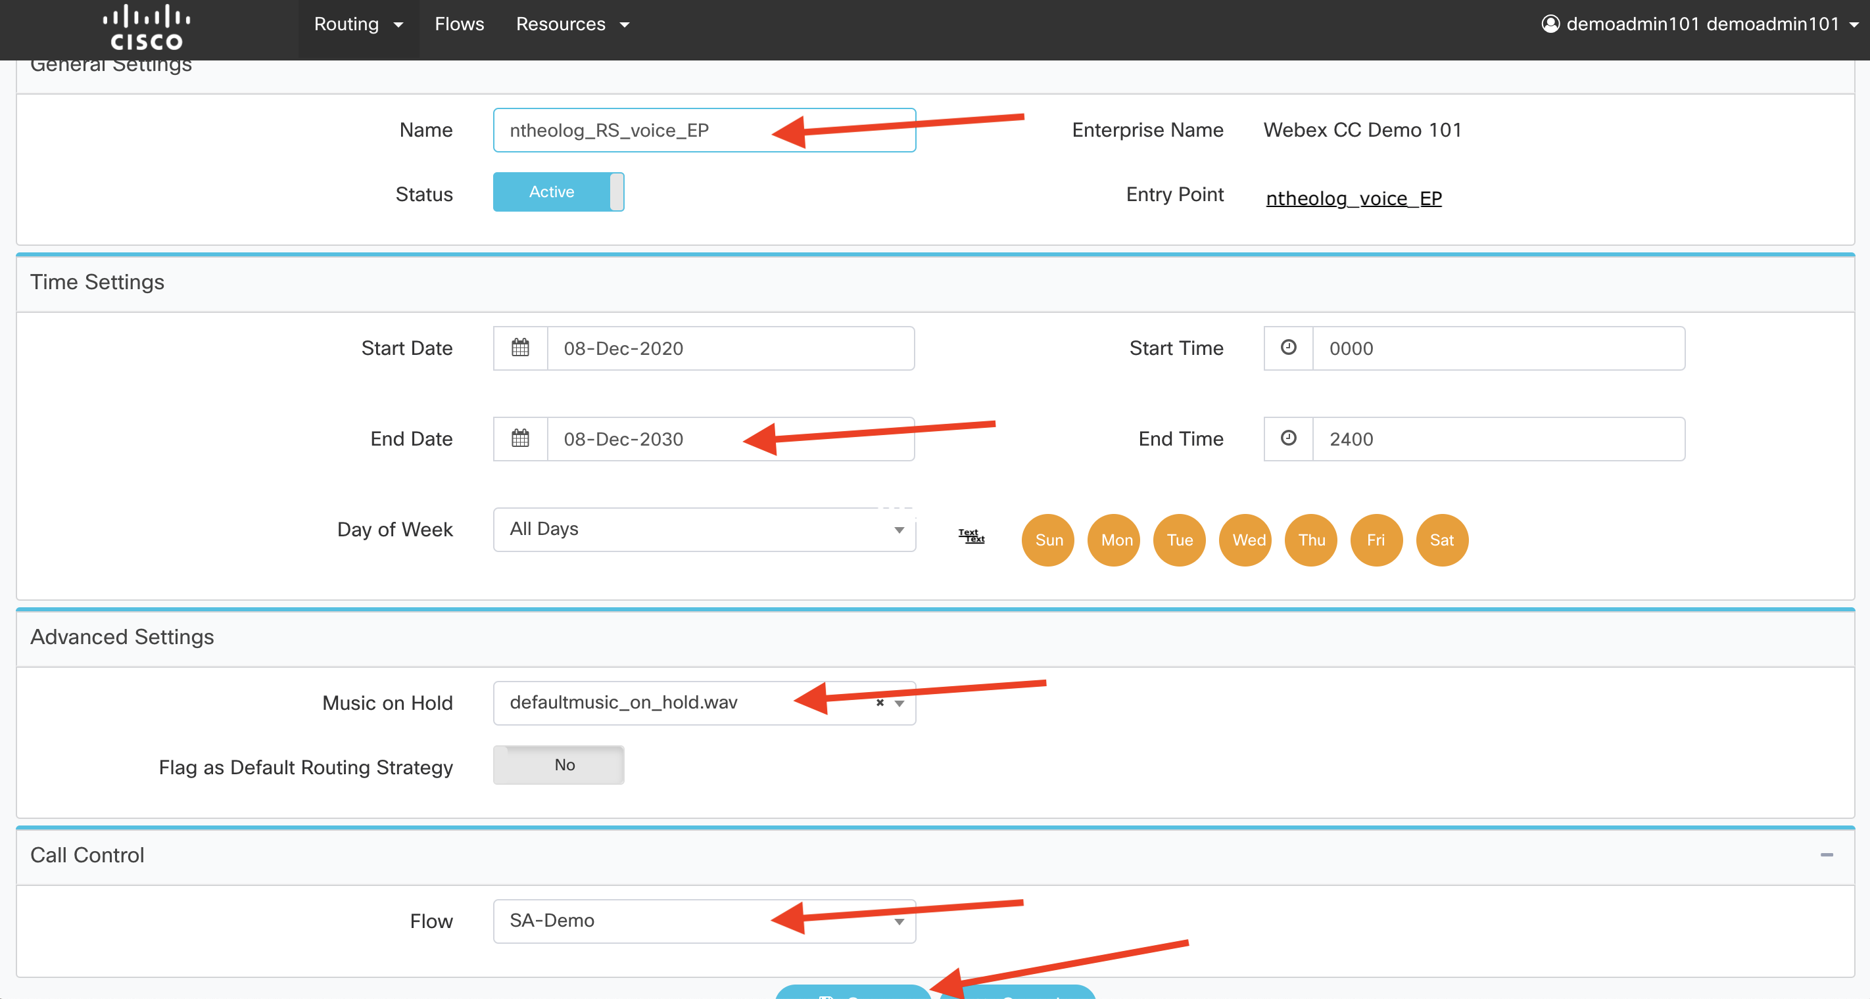
Step10: Entry point routing strategy
Enter the Routing strategy name
Change end Date to future date
Select (pull-down) default music on hold
Select (pull-down) your newly created Flow (<username>_flow)
save

Slide 25
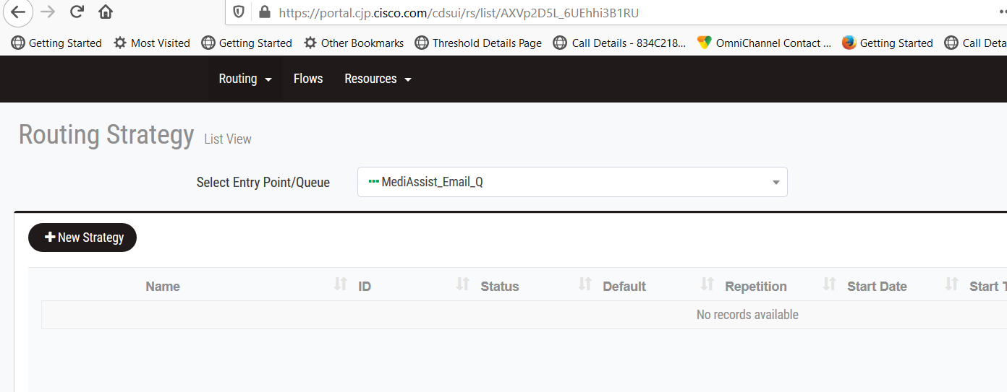
Step11: Queue routing strategy
Now from the routing strategy page, select the ‘queue’ that you created and click on ‘New Strategy’ button

Slide 26
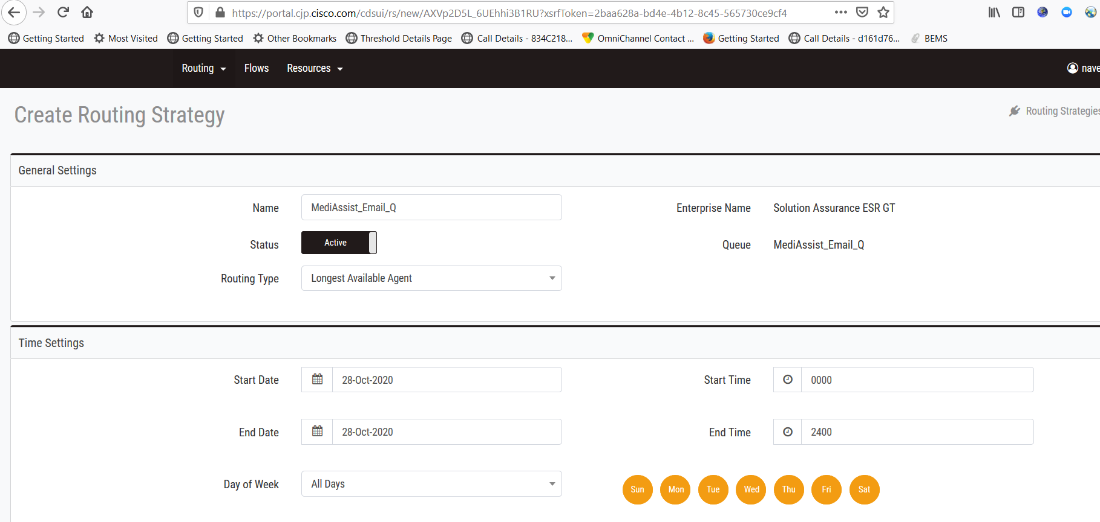
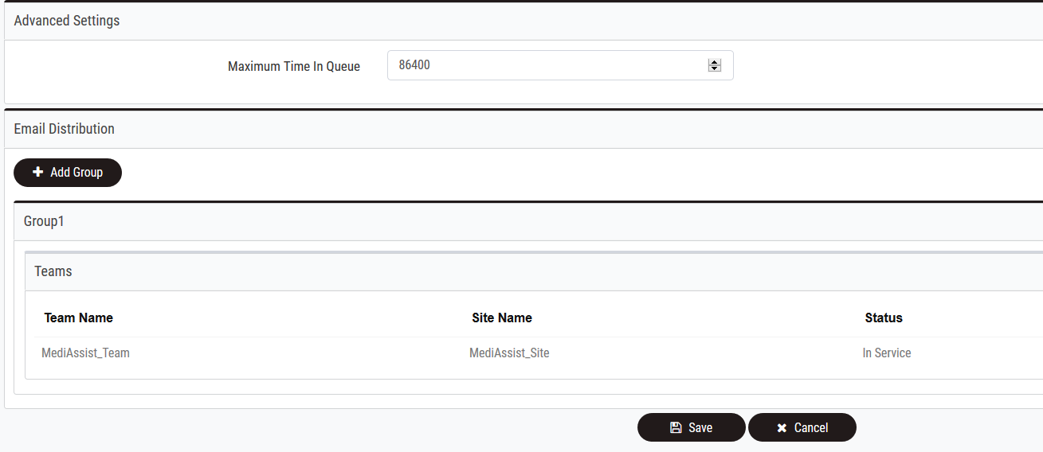
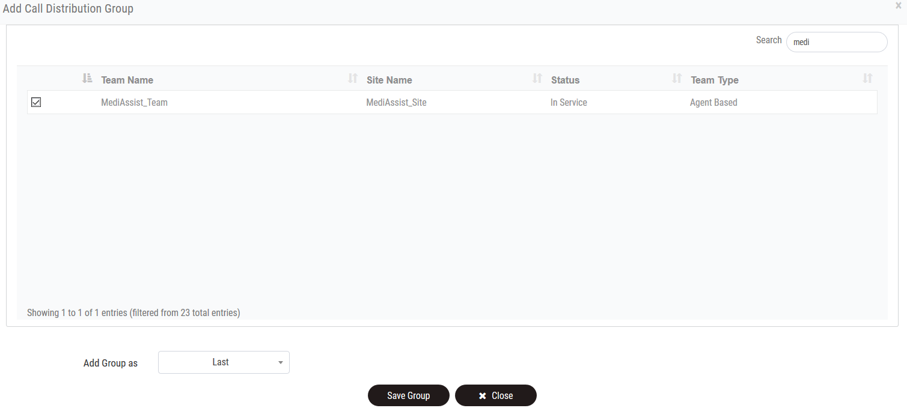
Step12: Queue routing strategy (Cont.)
Enter the Queue Name and Select the ‘Routing Type’ from the drop down.
Enter the 'Time Settings', 'Advanced settings' enter the default music on hold....
Select the Team to which the contact should be delivered and click save group.
Now click save to complete Queue routing strategy settings.

Slide 27
Step13: Agent Login to Desktop

Slide 28
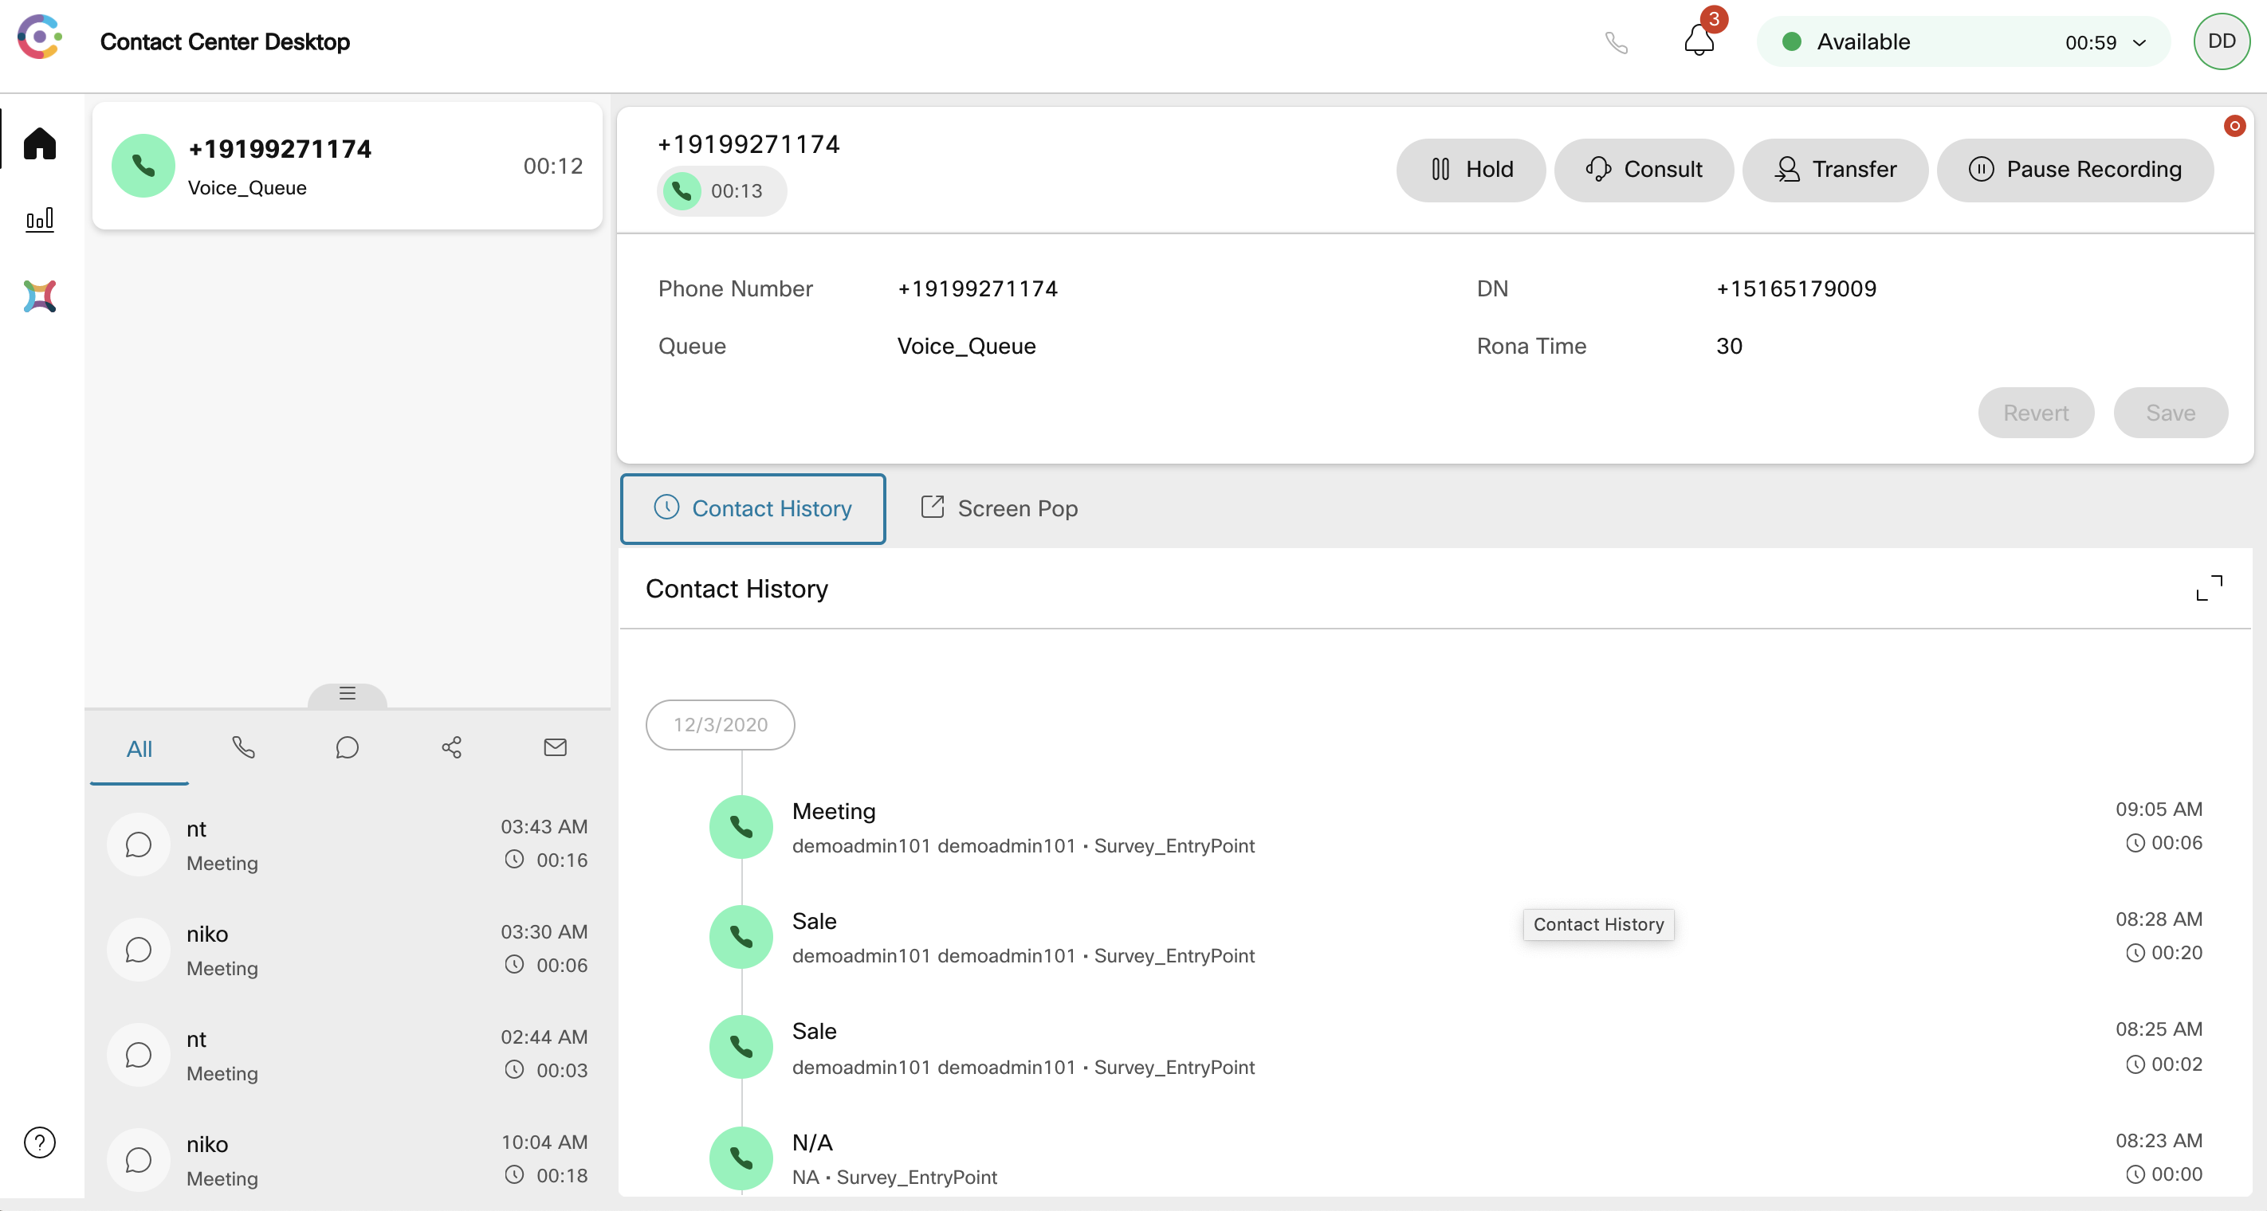
Step14: Agent Desktop – Call offered to Agent and Accepted
When logging into the Agent be sure to select your newly created Team otherwise, you get logged into the default team.
Once the agent goes Available, the voice will be offered to the agent.

Slide 29
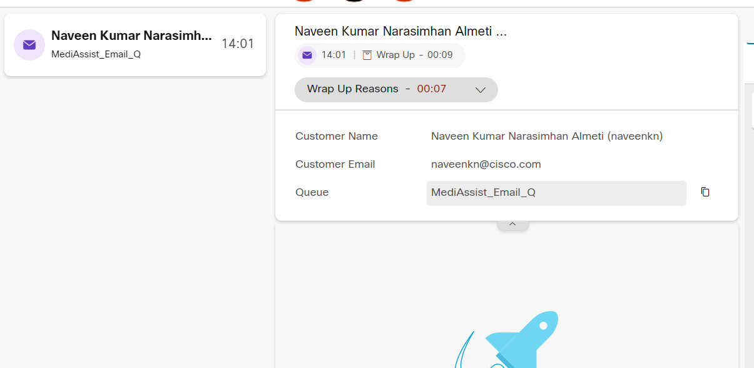
Step15: Agent Closes the task
Adds wrap up and closes the task

Slide 30
Summary:
Initial configurations for a voice to work with Entry Point, Queue and their corresponding Routing Strategy settings are covered.

